Slide 1
Introduction to Terraform

Slide 2
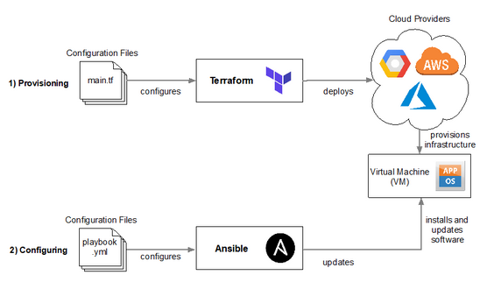
What is terraform
Infrastructure as Code
Open source declarative language (HCL)
Vendor Agnostic
Extensible

Slide 3
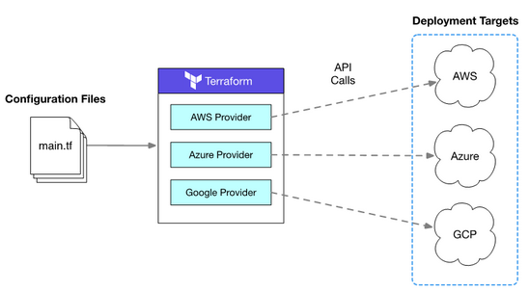
Providers
Extends HCL with Vendor specific functionality
Example providers
AWS
Datadog
GCP etc.
Can write custom providers
e.g.custom S3 provider with org defaults
Frequently ahead of official vendor tools
Cloudformation support infamously slow to arrive

Slide 4
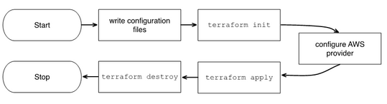
Terraform Lifecycle
Write you terraform config
Initialize the module and provider
Plan to view changes
Apply new config and changes
Teardown infrastructure

Slide 5
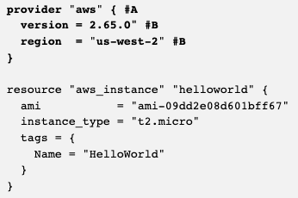
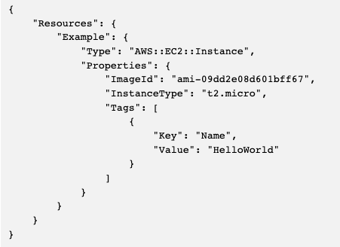
Example Resource
Deploys ubuntu server on t2.micro instance

Slide 6
State
Actions in terraform are stateful
Resources get an id and version number
Generate local state file
Can view resources with “terraform show”
State is backed up in .backup file
Remote state is possible and desirable
E.g. can Stores state in a S3 bucket

Slide 7
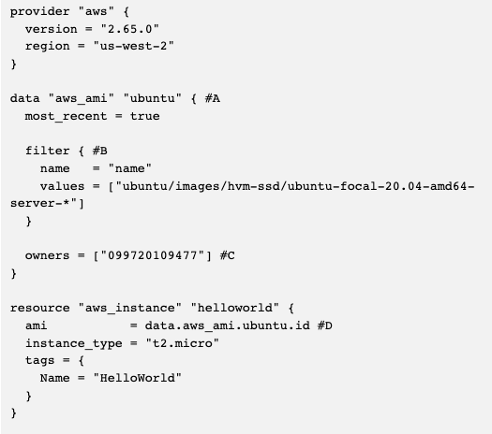
Data sources and State example
Terraform not just for static resources
Can read from data sources
Unmanaged resources
Not directly controlled by terraform
E.g. lookup on latest ubuntu ami in ubuntu aws account
Resources can reference other resources

Slide 8
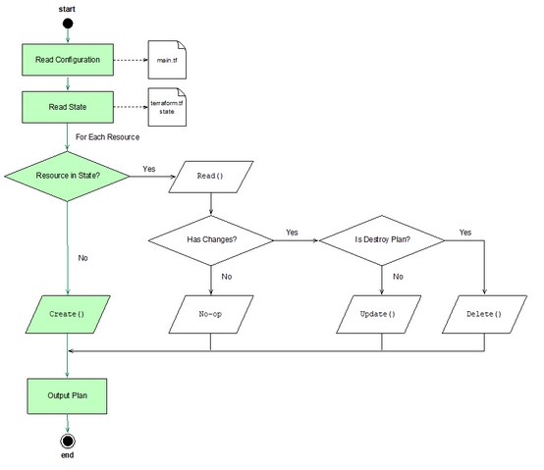
State: Mutable and Immutable Changes
Terraform will through this flow on plan
Aim is to be idempotent
If the resources are found in state then
Will test resources against reality
If no changes then No-op
If changes found the either update or delete

Slide 9
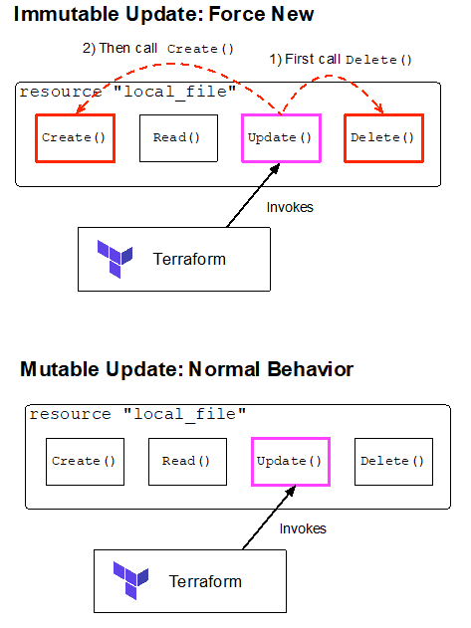
State: Mutable and Immutable Changes
Model is for immutable infrastructure
Some change require a forced new version
E.g. Change a subnet for EC2
Some changes can be mutation
E.g. change a tag on EC2
Terraform plan/apply will tell you
Notes:
Demo immutable - change subnet to subnet-f71b0980

Slide 10
Config Drift
Small change can be detected by rerunning terraform plan
E.g. EC2 tag change
Some changes make local state irreconcilable with actual state and require recreate
Terraform refresh reconciles state and updates state file prior to plan/apply/destroy
Subsequent plan/apply/destroy commands will be accurate
Notes:
Demo 2 - create 2 Ec2 instances and delete one, then terraform plan

Slide 11
Variables
Terraform is a full language
Has data structures you might expect and operations on these
E.g. lists, maps etc.
Can pass data to files with variables
Can construct local variables for expensive computations
Can iterate and create dynamic content form variables
Can create pass variable to text file data sources
E.g. can create a cloud-init template for EC2 and parameterize the file
User data for Autoscaling group or EC2 instance can reference data source of completed file

Slide 12
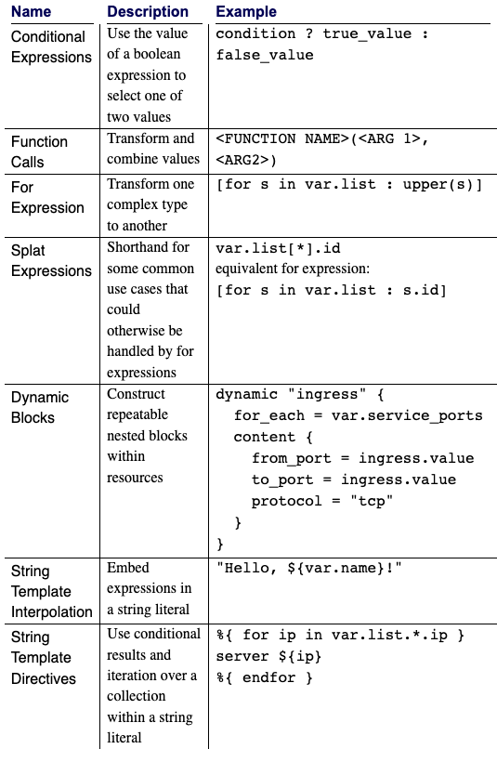
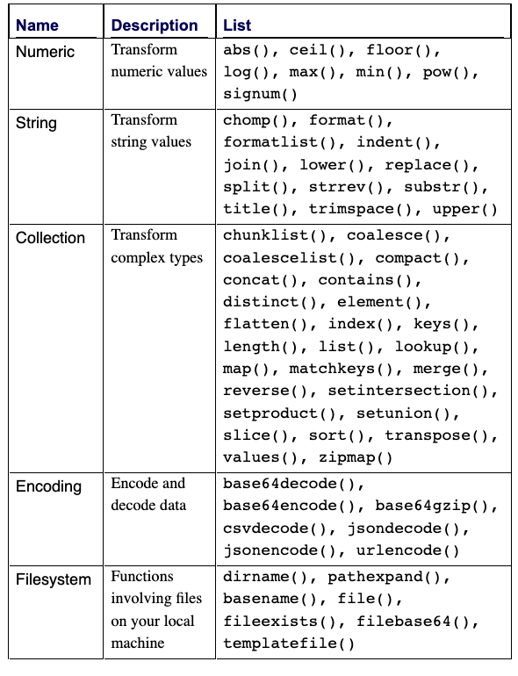
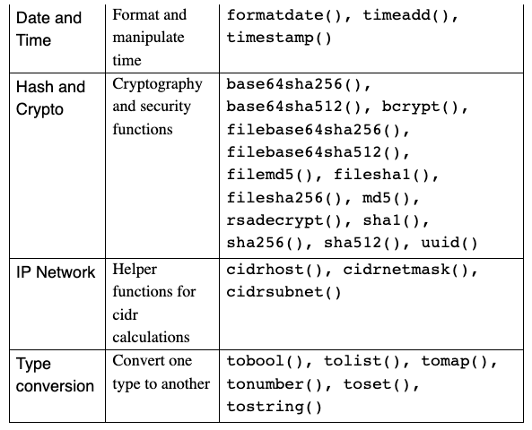
Variables and Operations

Slide 13
Modules
Allow for reusable code
E.g. can deploy a stack across multiple environments by passing different variables
Modules can be written locally or reuse others from remote sources
Terraform module repo
Github etc.
Allows for sensible template for a org to remove effort

Slide 14
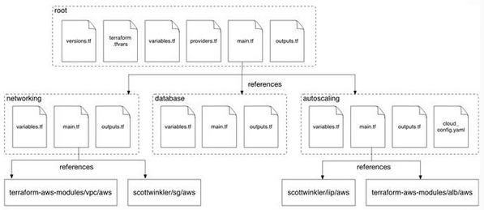
Module Structure & Data Passing
Terraform has an opinionated module structure
Variables.tf for input
Main.tf for resources
Output.tf for output e.g. calculated values like subnet IDs
Root will define overall project and additional files
Versions.tf
Terraform.tfvars
Providers.tf
secrets.tfvar

Slide 15
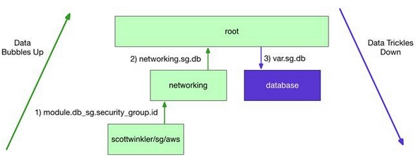
Module Data passing
Output are used to bubble up data
Variables can reference this bubbled up data in other modules

Slide 16
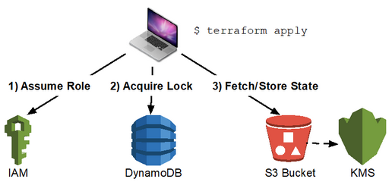
Remote State
Storing state remotely to share it is supported
Aim is to synchronize secrets etc. without having to add to source control
Also prevent race conditions and locking with multiple users

Slide 17
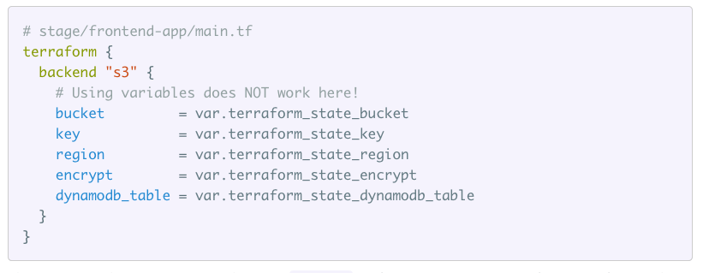
Remote Backend Limitations
Remote backend don’t support variables
Can’t parameterize the S3 backend to have a different backend for different environments e.g. QA and Prod
Need to duplicate code in your main.tf

Slide 18
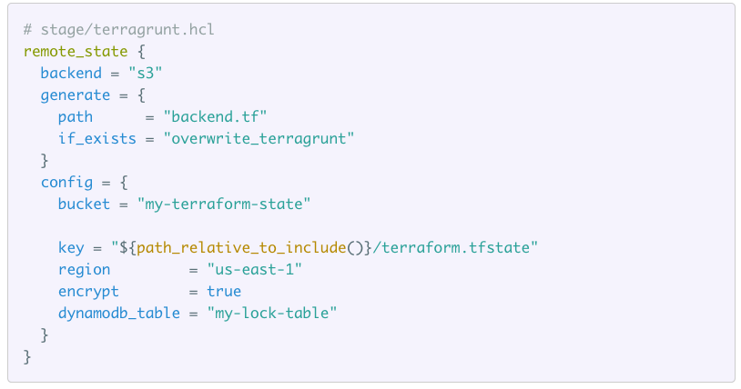
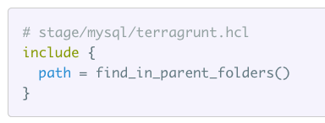
Terragrunt
Terragrunt is a wrapper around terraform
Aim is to reduce duplicated code e.g.
Allows you to define your remote state once per environment
No need to duplicate for each module, have it consume the one file

Slide 19
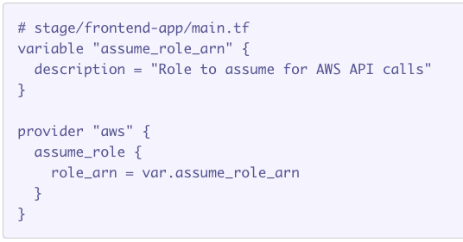
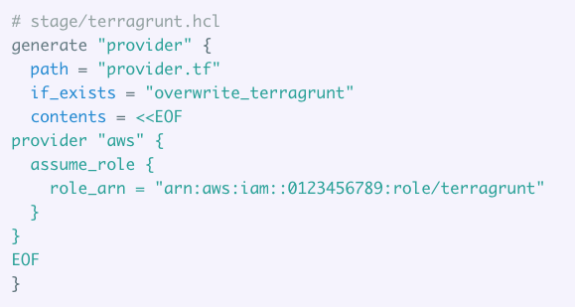
Terragrunt Providers
Allows you to specify you specify a provider once multiple modules
Generate the provider code instead of specifying it

